Slide 1
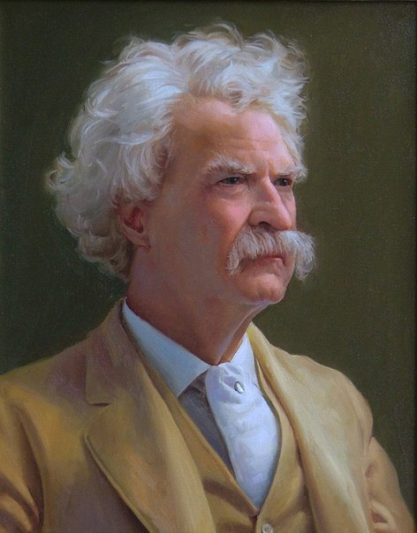

Slide 2
V –I have already known
+ - new information
? – I want to know more

Slide 3
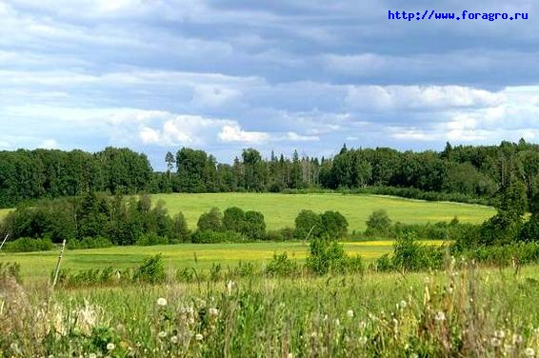
Relax
«ЧЕТЫРЕ СТИХИИ»

Slide 4
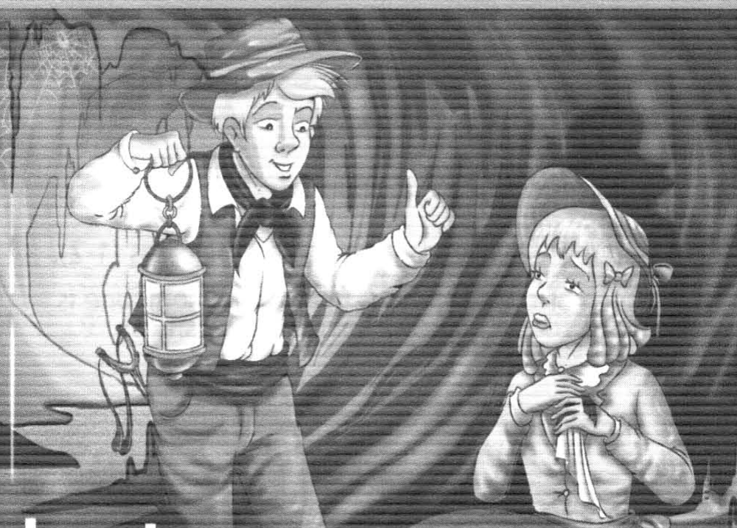

Slide 5
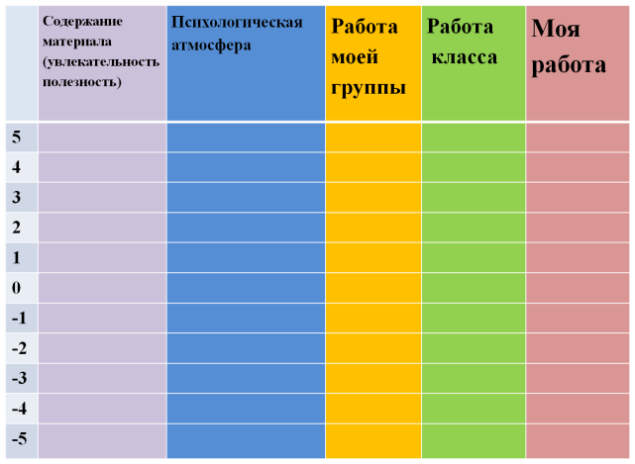

Slide 6
Got acquainted with …
Found out…
Learnt…
Remembered…
Review the material about…
Done…
Read…
Written…

